Slide 1
COMP 4290
Week 10 - Friday

Slide 2
Last time
Intrusion detection systems
Database background
Database security requirements

Slide 3
Questions?

Slide 4
Project 3

Slide 5
Nfaly Toure Presents

Slide 6
Finish Database Reliability and Integrity

Slide 7
Concurrency
Most database systems allow more than one user or process to access it at the same time
Updates must be controlled to avoid race conditions
Race conditions are sequences of commands that result in different states depending on timing
If there is one ticket left to a Bad Bunny concert, it should be impossible for two people to buy it
Commands that both query (is there a ticket remaining) and update (buy the ticket) should be executed atomically
Reading data also needs to be protected
If a user is writing data, it should be locked so that it can't be read

Slide 8
Constraints
A monitor is the part of the DBMS responsible for structural integrity
Range comparisons check newly entered numerical data for sanity
Filters or patterns can be arbitrarily complex to make sure that a zip code or a VIN is correctly formatted
The job of a DBA is to set these up, as well as the more complex state and transition constraints

Slide 9
State and transition constraints
A state constraint is a characteristic that should be invariant over the database
Only one person is labeled president
Only one table has a given name
If such a constraint is violated, something has gone wrong in the database
A transition constraint must be met before certain changes can be made to the database
A vacant position has to be listed before a new employee can be added
A student record must exist before that student's ID can be added to a class

Slide 10
Sensitive Data

Slide 11
Sensitive data
Sensitive data are data that should not be made public
This is the confidentiality aspect of a database
It can be sensitive because it is:
Inherently sensitive
From a sensitive source
Declared sensitive
Part of a sensitive record or field
Sensitive in relation to previously disclosed information

Slide 12
Access decisions
The DBA has to make decisions about who can access what based on a number of factors
Availability of data
What policies should be used to prevent two users from accessing the same data?
What if one user locks the data up, preventing the other from reading?
Acceptability of access
Sensitivity is complex
Can I get a list of people whose fines are not zero, if the FINES field is sensitive?
As a student, can I get statistical data about an exam?
Assurance of authenticity
Time or location can be used to determine access
Accessing some information may make others inaccessible

Slide 13
Types of disclosure
The most serious disclosure of sensitive data is its exact value
Bounds can also be disclosed
Example: highest salary and lowest salary
If the user can manipulate the bounds, he or she can search for specific values
Negative result
Felonies is not zero
Visits to the oncology ward is not zero
Existence
Knowing that a field even exists means someone is using it
Probable value
How many people are in Bob's dorm room? 2
How many people in Bob's dorm room pirate movies? 1
There's a 50% chance that Bob pirates movies

Slide 14
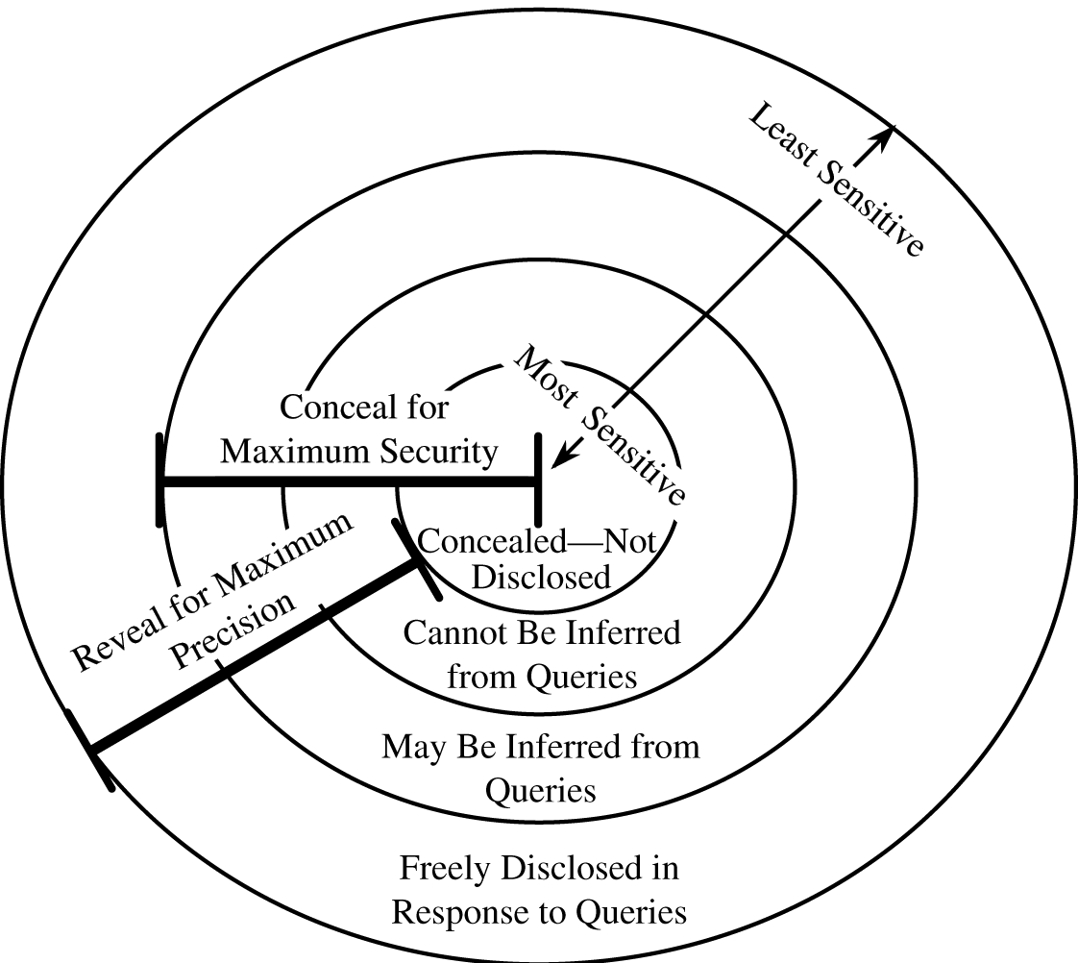
Security versus precision
The goal of a database is to collect data to analyze and get users' jobs done
The DBA is trying to keep the data secure
Users want to access data easily
Precision is knowing the data you need to know
In a perfect world, we could have perfect precision and perfect security, but we don't live there

Slide 15
Inference

Slide 16
Direct attack
In a direct attack on sensitive information, a user will try to determine the values of a sensitive field with the right query
Name | Sex | Race | Aid | Fines | Drugs | Dorm
Adams | M | C | 5000 | 45 | 1 | Holmes
Bailey | M | B | 0 | 0 | 0 | Grey
Chin | F | A | 3000 | 20 | 0 | West
Dewitt | M | B | 1000 | 35 | 3 | Grey
Earhart | F | C | 2000 | 95 | 1 | Holmes
Fein | F | C | 1000 | 15 | 0 | West
Groff | M | C | 4000 | 0 | 3 | West
Hill | F | B | 5000 | 10 | 2 | Holmes
Koch | F | C | 0 | 0 | 1 | West
Liu | F | A | 0 | 10 | 2 | Grey
Majors | M | C | 2000 | 0 | 2 | Grey

Slide 17
Direct attack
SELECT NAME FROM STUDENTS WHERE SEX="M" AND DRUGS="1"
This query might be rejected because it asks for a specific value of sensitive field Drugs
SELECT NAME FROM STUDENTS WHERE (SEX="M" AND DRUGS="1") OR (SEX<>"M" AND SEX<>"F") OR (DORM="AYRES")
This query might be accepted by some systems because it appears to mask the sensitive information by including other information
However, the additional OR clauses add no records

Slide 18
Indirect attack
To avoid leaking sensitive data, some DBMSs allow statistics to be reported
Each of the following statistics can be attacked in different ways:
Sum
Count
Mean
Median

Slide 19
Sum example
A single carefully chosen query can leak information
The sum of financial aid broken down by gender and dorm reveals that no female student in Grey receives financial aid
If we know that Liu is a female student in Grey, we know she gets no aid

Slide 20
Count
Count statistics are often released in addition to sum
Together these two allow averages to be computed
Alternatively, if count and average are released, sums could be computed
A query of the count of students reveals that there is 1 male in Holmes and 1 male in Grey
We can get their names because that is unprotected data
Using the previous sums of financial aid, we can determine exactly how much they get

Slide 21
Mean
If you are able to get means for slightly different sets, you can determine the values for the difference of those sets
Example (with made-up numbers)
Average salary for an Otterbein employee: $47,600
Average salary for all Otterbein employees except for the president: $47,000
Given that there are 500 employees at Otterbein, how much does Dr. Comerford make?

Slide 22
Medians
We can use the median values of lists to reconstruct the user who has that median value
Some extra information might be needed
If someone knows that Majors is the only male whose drug-use score is 2, they can find the median of the financial aid value for males and the median of the financial aid value for people whose drug-use score is 2
If the two values match, that number is Majors's aid, with high probability

Slide 23
Tracker attacks
A DBMS may refuse to give back a result that has only a single record
COUNT(SELECT * FROM STUDENTS WHERE SEX="F" AND RACE="C" AND DORM="HOLMES")
However, we can use the laws of set theory to defeat the DBMS
|A ∩ B ∩ C| = |A| - |A ∩ (B ∩ C)^{c}|
Thus, we find:
COUNT(SELECT * FROM STUDENTS WHERE SEX="F")
COUNT(SELECT * FROM STUDENTS WHERE SEX="F" AND (RACE<>"C" AND DORM<>"HOLMES"))
Then, we subtract the two values
This attack can be extended to a system of linear equations to solve for a particular set of values

Slide 24
Controls for statistic inference attacks
Suppression means that sensitive values are not reported
Concealing means that values close to the sensitive values are returned, but not the values themselves
This represents the tension between security and precision

Slide 25
Limited response suppression
The n items over k percent rule means that the data should not be reported if the number of records n makes up more than k percent of the total
This is a standard rule for suppression
However, if counts are supplied, additional values may need to be hidden so that the hidden values can't be computed
It's like Sudoku!

Slide 26
Combined results
Instead of failing to report values, we can combine ranges
Though drug use values of 0, 1, 2, and 3 would allow us to recover individual names, we can report the category of 0 – 1 and 2 – 3
Numerical values such as money can reported in ranges as well
Finally, values could be rounded (note that this is essentially the same as using ranges)

Slide 27
Randomization
In random sample control, results are given from a random sample of the database, not the whole thing
Useless for count, but not bad for mean
To prevent users from getting more information from repeated queries, the random sample for a given query should always be the same
Random data perturbation adds small amounts of error to each value
Because the errors are positive or negative, means and sums will be only slightly affected

Slide 28
Inference summary
Suppress obviously sensitive information
Easy, but incomplete
Track what the user knows
Expensive in terms of computation and storage requirements
Analysis may be difficult
Multiple users can conspire together
Disguise the data
Data is hidden
Users who are not trying to get sensitive data get slightly wrong answers

Slide 29
Multilevel Databases

Slide 30
Database security isn't simple
A single element may have different security from other values in the record or other elements in the same attribute
Sensitive and non-sensitive might not be enough categories to capture all possible confidentiality relationships
The security of an aggregate (sums, counts, etc.) may be different from the security of its parts
We want to add different levels of security, similar to Bell-La Padula

Slide 31
Integrity and confidentiality
Integrity is difficult, but we can assign levels of trust
It is necessarily not going to be as rigorous as Biba
Confidentiality
Difficult and causes redundancies since top secret information cannot be visible in any way to low clearance users
Worse, we don't want to leak any information by preventing a record from being added with a particular primary key (because there is a hidden record that already has that primary key)
Polyinstantiation means that records with similar or identical primary keys (but different data) can exist at different security levels

Slide 32
Proposals for multilevel databases
Partitioning
Each security level is a separate database
Simple, but destroys redundancy and makes access harder
Encryption
A single key for a security level isn't good enough: a break in the key reveals everything
A key for every record (or field) gives good security, but the time and space overhead is huge

Slide 33
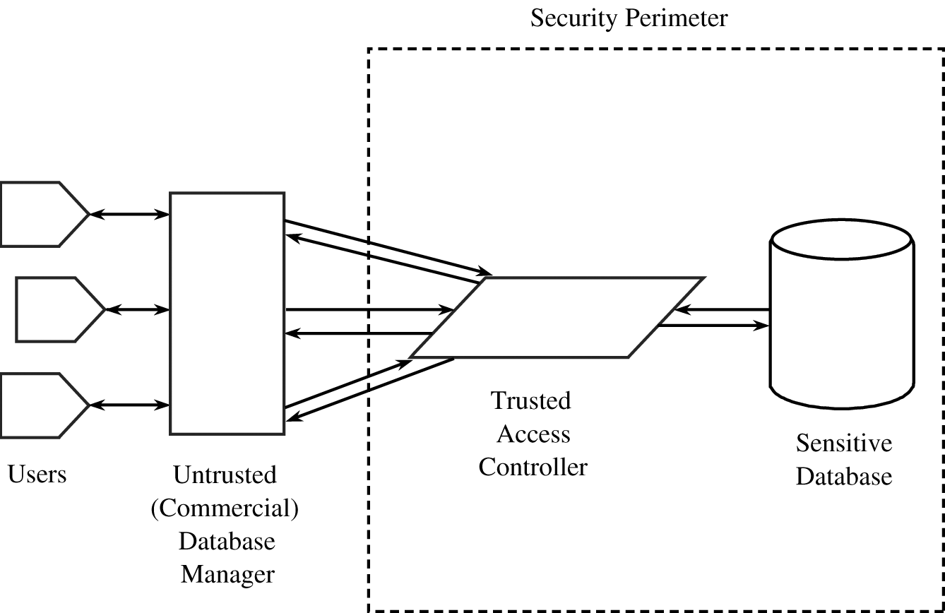
Integrity lock databases
An integrity lock database has a security label for each item, which is:
Unforgeable
Unique
Concealed (even the sensitivity level is unknown)
If these labels are preserved on the data storage side, an untrusted front-end can be used as long as it has good authentication
Storage requirements are heavy

Slide 34
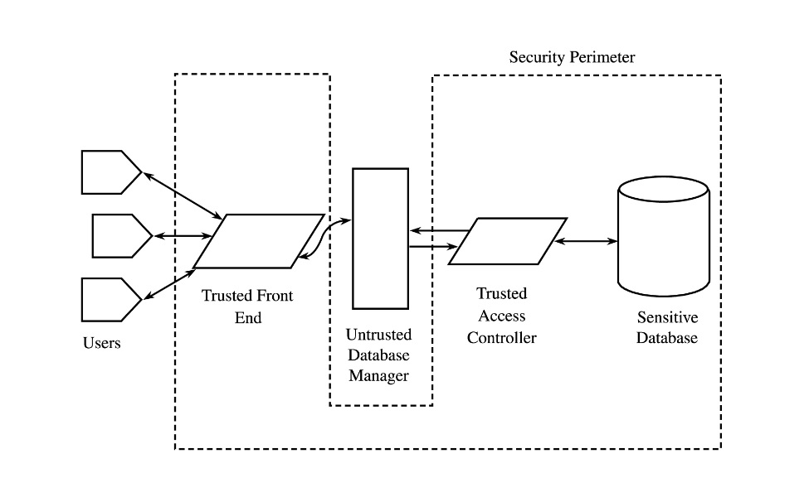
Trusted front-end databases
A trusted front-end is also known as a guard
The idea isn't that different from an integrity lock database with an untrusted front end
It is trying to leverage DBMS tools that are familiar to most DBAs
The front-end can be configured instead of interacting with database internals
The system can be inefficient because a lot of data can be retrieved and then discarded by the front end if it isn't at the right level

Slide 35
Ticket Out the Door

Slide 36
Upcoming

Slide 37
Next time…
Data mining
Cloud computing
Anu Regmi presents

Slide 38
Reminders
Work on Project 3
User names and passwords and phrases need to be turned in next Friday in class!

